Slide 1
Important Presenter Notes
Please save this file using the Session Code and Title, e.g., “FIN08_BestPracticesWithYearEndClosing”
Slides 1-4 contain presenter notes and are hidden.
Slides 5 and following are slide layouts. Delete any you don’t use.
Include your photo & company logo on your intro slide only (slide 6)
During your introduction, it is appropriate to provide a brief background (1 minute or less) on your organization.

Slide 2
Important Presenter Notes
Attendees love when you submit your slides and reference materials (if using) in advance
Submit your slides and reference materials by Sept. 30 via OneDrive - http://1drv.ms/1U1xUAy
CRMUG will review and edit slides if needed. If edited, CRMUG will email your final slides.
Check out the Speaker Guide for more details!

Slide 3
Quick Best Practices
Frame your presentation by answering:
What do you want your audience to learn?
What do you want your audience to do differently?
What result or outcomes do you want your audience to realize?
Clarify your session objectives up front

Slide 4
Quick Best Practices
Use more pictures, far less words (7 words on a slide is wonderful).
Use varying communication methods and media to increase attention and interaction (e.g., presentation or demonstration, small group discussion, polls, video, etc.)

Slide 5
Session code: DEV01 New Web API for CRM Online Development
Mitch Milam, xRM Coaches
Notes:
Title slide to be customized

Slide 6


Introduction – Mitch Milam
Head Coach, xRM Coaches
Independent consultant
Ten–Time Dynamics CRM MVP
Notes:
Introduction slide to be customized. Add intro slide for each panelist.

Slide 7
Session Objectives
Review the major components of the Web API Preview
Discuss what is required to write code against the API
Notes:
Objectives slide to be customized

Slide 8
Agenda
Web API Overview
Technical Specifics
Service Configuration
Writing Code
Final Q&A
Closing & Surveys
Notes:
Agenda slide to be customized

Slide 9
<HEADer TExt: Size 30pt>
<Main Topic 1: Size 28pt>
<Subtopic: Size 24 pt>
<Main Topic 2: Size 28pt>
<Subtopic: Size 24 pt>
<Main Topic 3: Size 28pt>
<Subtopic: Size 24 pt>
Notes:
Example content slide

Slide 10
overview

Slide 11
What is the Web API Preview?
Implements the OData (Open Data Protocol) v4 for building and consuming RESTful APIs over rich data sources

Slide 12
New, Better, Different
Eventually this Web API will replace:
The current Organization Service (2011 SOAP endpoint)
The Organization Data Service (OData v2 REST endpoint)
Both of these existing web services will be available for years to come which will enable a gradual transition to a single Web API

Slide 13
Remember, it is a Preview
Not currently in the Technical Support channel
A feedback forum is available
Breaking changes are always possible
Do not use in production
** Only applies to 2015. Fully supported in 2016

Slide 14
Why is this useful to me?
It can eliminate the need for the SDK DLLs or generated code, in some situations
Provides a singular API for access via a variety of applications and platforms

Slide 15
Multiple Platforms
Desktop
Mobile
Web
Internal (CRM web resources)

Slide 16
Technical Specifics

Slide 17
Self–Documenting
Return all entity sets
[organization URI]/api/data
Return all metadata
[organization URI]/api/data/$metadata

Slide 18
Primitive types
2011 Endpoint Data type | Web API type
BigInt | Edm.Int64
Boolean | Edm.Boolean
CalendarRules | N/A
Customer | Single-valued navigation properties
DateTime | Edm.DateTimeOffset
Decimal | Edm.Decimal
Double | Edm.Double
EntityName | Edm.String
Image | Edm.Binary
Integer | Edm.Int32
Lookup | Single-valued navigation property
ManagedProperty | N/A
Memo | Edm.String
Money | Edm.Decimal
Owner | Single-valued navigation properties
PartyList | Collection-valued navigation property to the activityparty entity type.
Picklist | Edm.Int32
State | Edm.Int32
Status | Edm.Int32
String | Edm.String
Uniqueidentifier | Edm.Guid

Slide 19
Entity Types
Label | Description
[Description] | A description of the entity type.
Collection URL | The URL to retrieve entities of this type.
Display Name | The Display Name for the entity.
Primary Key | The Primary Key for the entity.

Slide 20
Type Inheritance
All entities inherit from crmbaseentity
Activities inherit from activitypointer
SystemUser and Team inherit from owner

Slide 21
Entity Properties
Property | Description
Name | The name of the property you will use in code.
Display Name | The display name of the property that may be visible in the application.
Type | The type of the property. All properties have primitive types.
Computed | Whether the value of the property is set by the system.
Permission | Only two options are available here: Read or ReadWrite. When a property only has Read permission, you cannot set the value of the property.
Description | A description of the property.

Slide 22
Navigation Properties
Property | Description
Name | The name of the property you will use in code.
Type | The entity type that can be set for the navigation property.
Self-referential Partner | Usually in a 1:N relationship there is a corresponding collection-valued navigation property on the other entity with the same name. However, when the navigation property represents a self-referential relationship there cannot be two navigation properties with the same name. In this case the single-valued navigation property will be prefixed by ‘Referencing’ and the collection-valued navigation property will be prefixed by ‘Referenced’.

Slide 23
Bound Functions
Current Functions:
GetSavedQueries
GetUserQueries

Slide 24
Unbound Functions
Perform operations which have no side-effects.

Slide 25
Unbound Function List
CalculateTotalTimeIncident
CheckPromoteEmail
ExpandCalendar ExportFieldTranslation
GetAllTimeZonesWithDisplayName
GetTimeZoneCodeByLocalizedName
RetrieveAuditPartitionList
RetrieveByTopIncidentProductKbArticle
RetrieveByTopIncidentSubjectKbArticle
RetrieveExchangeRate
RetrieveMailboxTrackingFolders
RetrieveOrganizationResources
RetrievePersonalWall
RetrievePrivilegeSet
RetrieveTeamPrivileges
RetrieveUserPrivileges
RetrieveUserQueues
RetrieveVersion
WhoAmI

Slide 26
Unbound Actions
Operations which have side-effects and are called using POST requests.
May require parameters
May or may not return a value

Slide 27
Unbound Actions List
AddItemCampaign
AddItemCampaignActivity
AddListMembersList
AddMemberList
AddMembersTeam
AddPrincipalToQueue
AddRecurrence
AddToQueue
AddUserToRecordTeam
ApplyRecordCreationAndUpdateRule
ApplyRoutingRule
AutoMapEntity
Book
CalculateActualValueOpportunity
CalculatePrice
CancelContract
CancelSalesOrder
CloneContract
CloneProduct
CloseIncident
CloseQuote
ConvertOwnerTeamToAccessTeam
ConvertQuoteToSalesOrder
ConvertSalesOrderToInvoice
CopyCampaign
CopyCampaignResponse
CopyDynamicListToStatic
CopyMembersList
CreateActivitiesList
CreateException
CreateInstance
DeleteAuditData
DeleteOpenInstances
DeliverIncomingEmail
DeliverPromoteEmail
DistributeCampaignActivity
FulfillSalesOrder
GenerateInvoiceFromOpportunity
GenerateQuoteFromOpportunity
GenerateSalesOrderFromOpportunity
GenerateSocialProfile
GetTrackingTokenEmail
ImportFieldTranslation
InstallSampleData
InstantiateFilters
LockInvoicePricing
LockSalesOrderPricing
LoseOpportunity
Merge
PickFromQueue
ProcessInboundEmail
PublishProductHierarchy
QualifyMemberList
ReassignObjectsOwner
ReassignObjectsSystemUser
Recalculate
ReleaseToQueue
RemoveFromQueue
RemoveItemCampaign
RemoveItemCampaignActivity
RemoveMemberList
RemoveMembersTeam
RemoveParent
RemoveRelated
RemoveUserFromRecordTeam
RenewContract
RenewEntitlement
Reschedule
ResetUserFilters
RevertProduct
ReviseQuote
RevokeAccess
RouteTo
SendEmail
SendEmailFromTemplate
SendFax
SetBusinessSystemUser
SetParentSystemUser
UninstallSampleData
UnlockInvoicePricing
UnlockSalesOrderPricing
WinOpportunity
WinQuote

Slide 28
The Difference Between Functions and Actions
Actions can change the data in the system
Functions should not

Slide 29
Complex Types
AppointmentProposal
AppointmentRequest
AppointmentsToIgnore
AttributeMapping
AttributePrivilege
AuditPartitionDetail
BookResponse
BooleanManagedProperty
BusinessNotification
BusinessNotificationParameter
CheckPromoteEmailResponse
ColumnSet
ConstraintRelation
EndpointCollection
ErrorInfo
MailboxTrackingFolderMapping
ObjectiveRelation
OrganizationDetail
OrganizationResources
PagingInfo
ProposalParty
RequiredResource
RescheduleResponse
ResourceInfo
RolePrivilege
SearchResults
TimeInfo
TimeInfoCollection
TraceInfo
ValidationResult
WhoAmIResponse

Slide 30
Enum Types
AccessRights
BusinessNotificationParameterType
BusinessNotificationSeverity
ConditionOperator
EndpointAccessType
EndpointType
JoinOperator
LogicalOperator
OrganizationState
PrivilegeDepth
PropagationOwnershipOptions
RollupType
SearchDirection
SubCode
TargetFieldType
TimeCode

Slide 31
Service configuration
Notes:
Example of section slide

Slide 32
Assumptions
Windows Azure subscription
Linked to your Office 365 business account
Dynamics CRM 2015 Online, Update 1
User with System Administrator role

Slide 33
The Process (one–time)
Enable the preview feature
Register the application with Azure Active Directory

Slide 34
Activate the Web Api preview feature

Slide 35
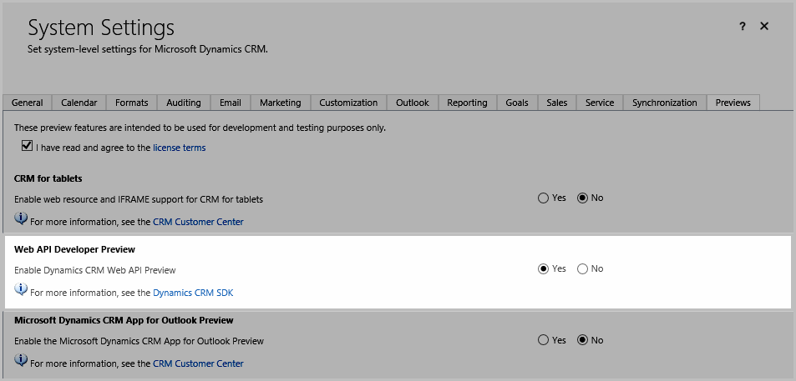
Activate the Web API Preview

Slide 36
Register your application

Slide 37

Application Registration Steps (part 1)
Open the Windows Azure Management Portal
https://manage.windowsazure.com
Navigate to Active Directory node
Select or create a new Active Directory
Notes:
Example content slide

Slide 38
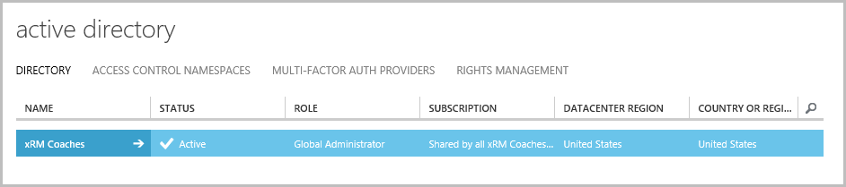
Azure Active Directory

Slide 39

Application Registration Steps (part 2)
Click the Applications tab
Click the Add button (bottom of screen)

Slide 40
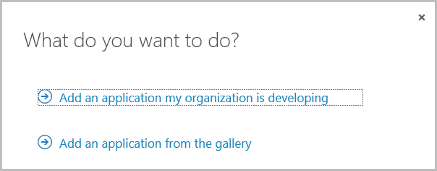
Application Registration Steps (part 2)
Select application type

Slide 41
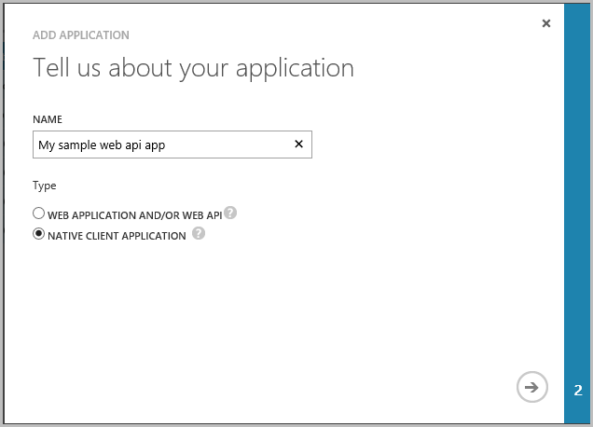
Application Registration Steps (part 2)

Slide 42
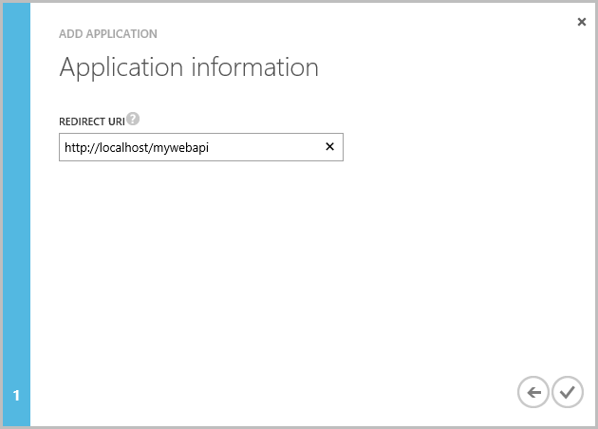
Application Registration Steps (part 2)

Slide 43
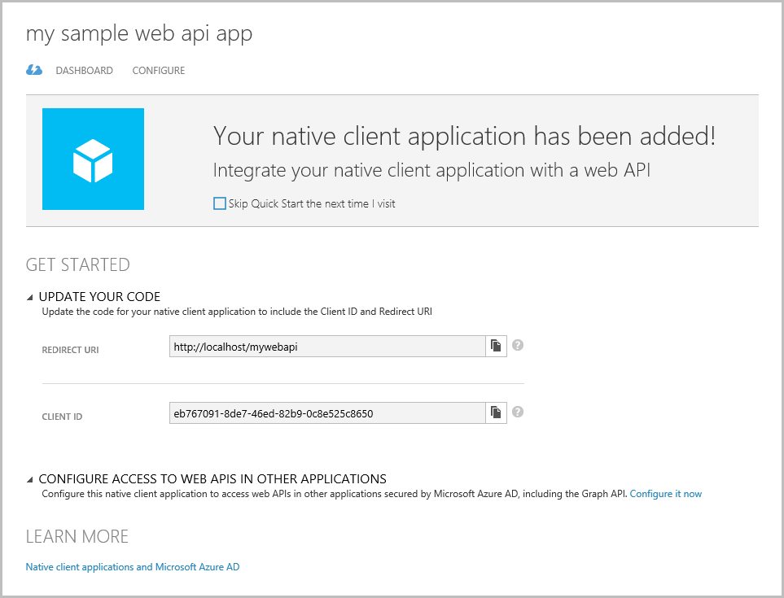
Application Registration Steps (part 2)

Slide 44
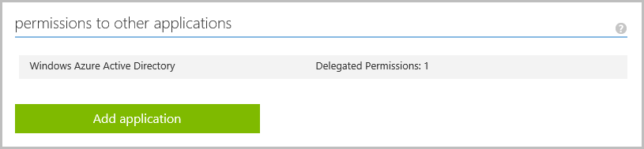
Application Registration Steps (part 2)
Select the Configure tab
Click Add application, in the permission section

Slide 45
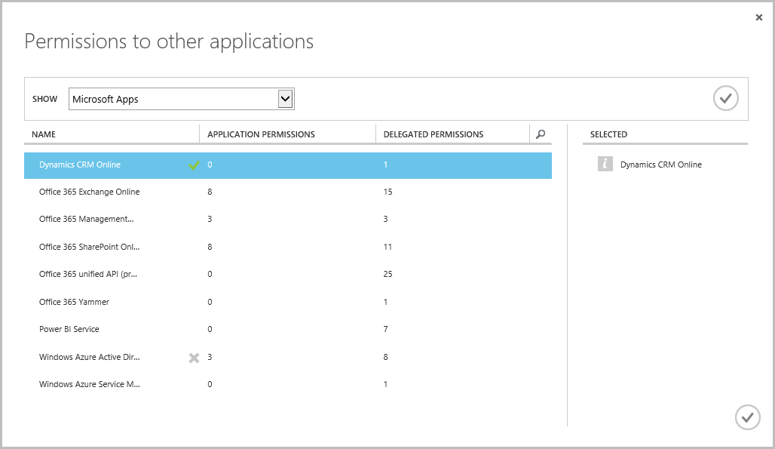
Application Registration Steps (part 2)
Select Dynamics CRM Online

Slide 46
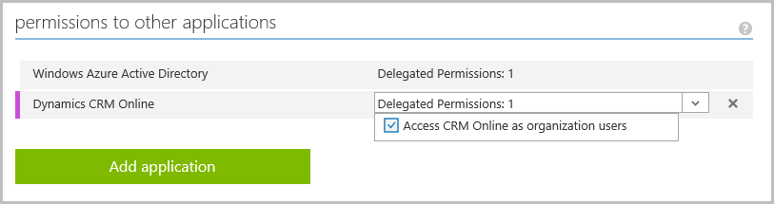
Application Registration Steps (part 2)
Add the Access CRM Online as organization users permission

Slide 47
Application Registration Steps (part 2)
Save your changes
Your application is now registered

Slide 48
Writing code

Slide 49
Learning Path
Review all Preview documentation and samples
http://tinyurl.com/CRMWebApiPreview
Working with OData
Working with JSON.NET
How OAuth works

Slide 50
Web API Helper Code
http://tinyurl.com/CRMWebApiHelper
Provides:
An authentication framework
Predefined methods for common operations

Slide 51
Web API Helper Methods
Create
Retrieve
RetrievePropertyValue
Update
UpdatePropertyValue
Upsert
Delete
DeletePropertyValue
Associate
Disassociate
RemoveReference
AddReference
InvokeBoundFunction
InvokeUnboundFunction
InvokeUnboundAction
QueryEntitySet
GetNextPage
ExecuteBatch
GetEntityList

Slide 52
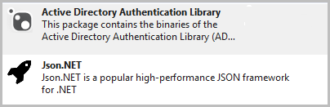
Required Nuget Packages

Slide 53
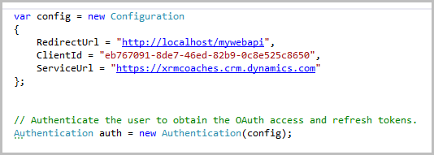
Authentication Configuration

Slide 54
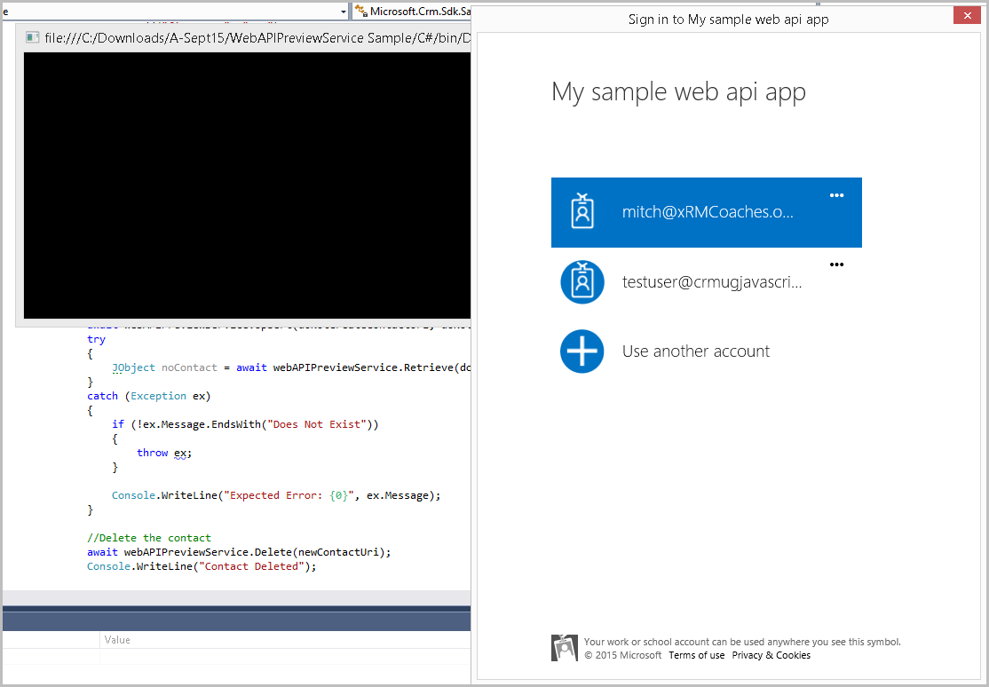
Authentication (Execution)

Slide 55
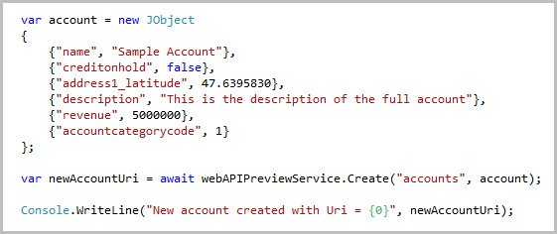
Sample: Create an Account

Slide 56
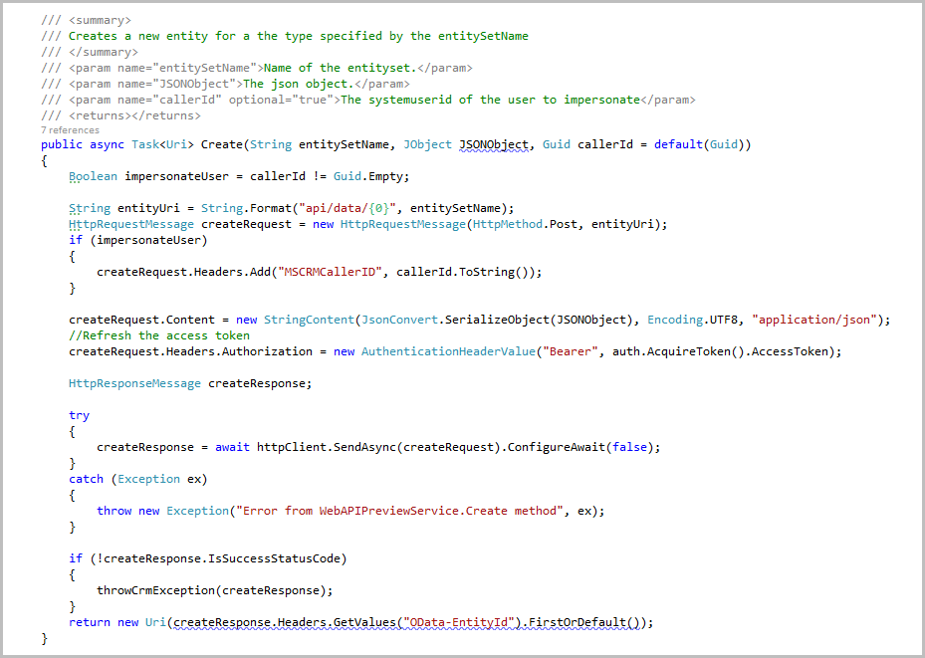
Create Helper Code

Slide 57
Generating strongly typed classes

Slide 58
Generating Strongly Typed Classes
Navigate to:
[organization URL]/api/data/$metadata
Save the resulting XML

Slide 59

Generating Strongly Typed Classes
Install the Odata v4 Client Code Generator Visual Studio extension

Slide 60
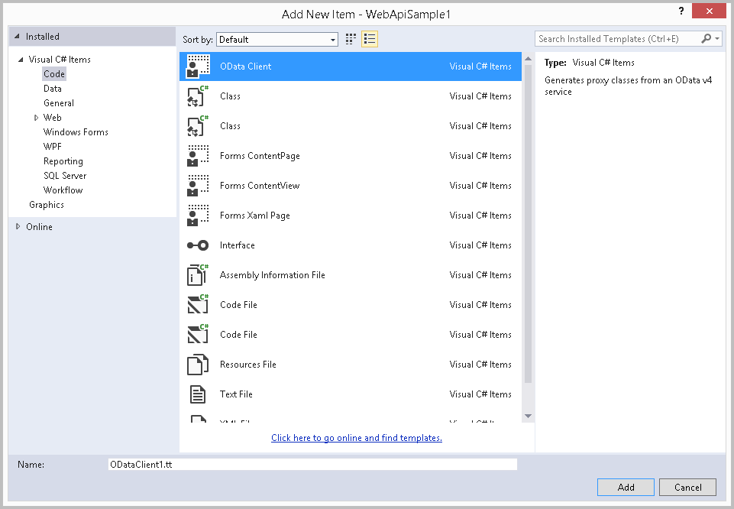
Generating Strongly Typed Classes
Add an OData Client template to the project

Slide 61
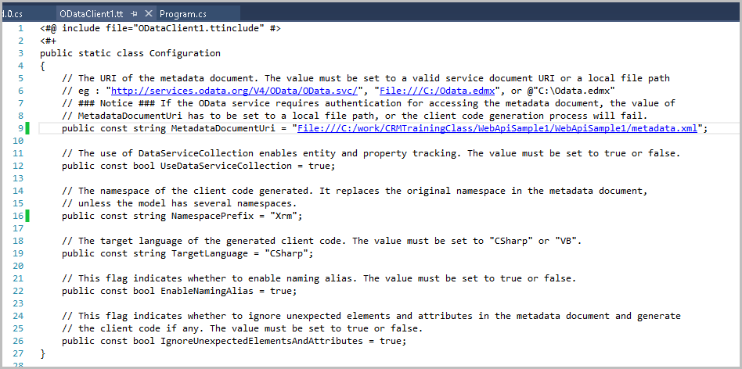
Generating Strongly Typed Classes
Modify the OData client template file

Slide 62
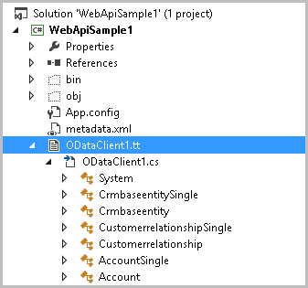
Generating Strongly Typed Classes
Resulting code generation

Slide 63
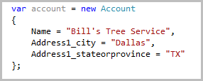
Generating Strongly Typed Classes
Using the generated code

Slide 64
Additional tools

Slide 65
Additional Tools
LINQPad Driver for Dynamics CRM Web API
https://crmlinqpadwebapi.codeplex.com
OData v4 Client Code Generator VS Extension
http://tinyurl.com/ODataClientGenerator
Web API Preview Documentation Generator
https://code.msdn.microsoft.com/Web-API-Preview-Documentati-f46694cd

Slide 66
Additional Tools
RESTBuilder
http://jlattimer.blogspot.com

Slide 67
Notes and developments (post–summit)

Slide 68
Notes and Developments
Fully–supported with Dynamics CRM 2016
The samples are still in the “Preview” section

Slide 69
Questions?

Slide 70
Contact Info
Mitch Milam, xRM Coaches
Email: mitch@xrmcoaches
Blog: Infinite–x.net
Twitter: @mitchmilam
Notes:
Add presenter contact info (no logos or images)

Slide 71
Thank you!
Please complete & turn in your survey now
Visit the online CRMUG Summit 2015 community to download these slides, ask questions, and connect with participants
Visit the CRMUG Medics in the HUB to get expert advice on your CRM-related problems!
Notes:
Thank you slide

Slide 72
Notes:
Final slide

